Slide 1


Pizza sales

Slide 2



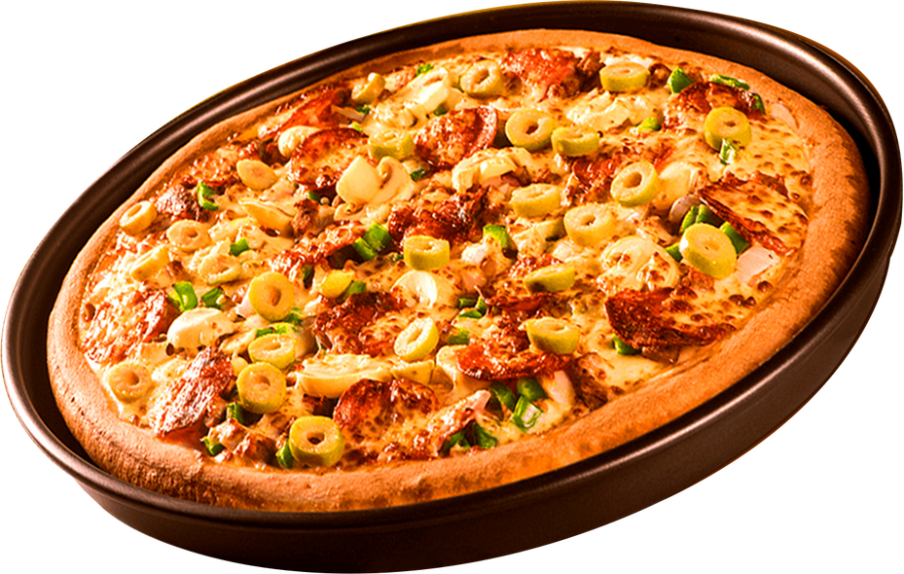
Mission :
Project Introduction – Pizza Sales Data Exploration
In this project, I analyzed a Pizza Sales dataset to gain insights into sales trends, customer preferences, and business performance.
The dataset consisted of multiple related tables, which I explored and analyzed using MySQL queries.
The dataset structure is as follows:
I performed various SQL queries to:
Explore the dataset and understand relationships between tables.
Analyze sales distribution by category, size, and price.
Identify top-selling pizzas and revenue-generating products.
Study time-based trends such as daily and monthly sales patterns.
The purpose of this project was to practice database querying skills and derive meaningful insights from a real-world-like dataset for decision-making in a pizza business scenario.

Slide 3


Dataset intro
Tables :
order_details
Columns: order_details_id, order_id, pizza_id, quantity
Rows: 48,621
pizzas
Columns: pizza_id, pizza_type_id, size, price
Rows: 97
pizza_types
Columns: pizza_type_id, name, category, ingredients
Rows: 33
orders
Columns: order_id, date, time
Rows: 21,350

Slide 4
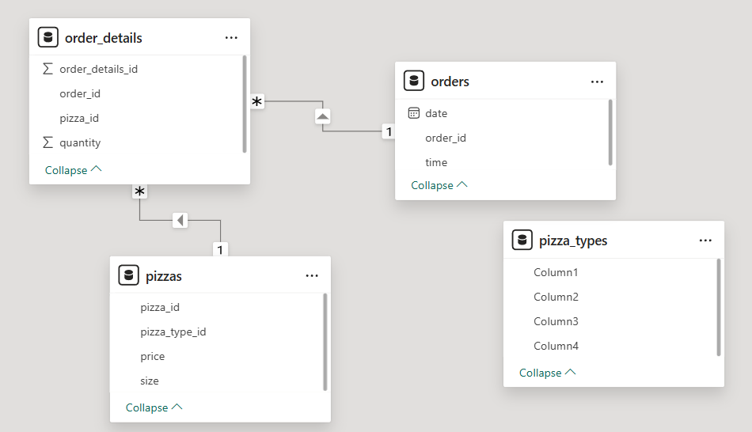
this is how our data model looks like :

Slide 5

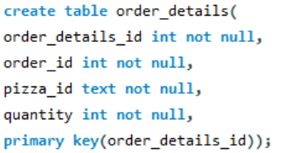

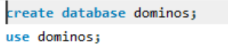
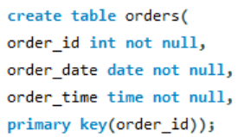
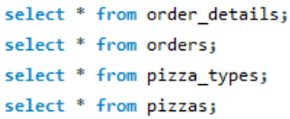
1. creation

Slide 6


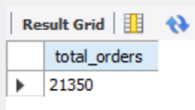
2. basic queries :
1. Retrieve the total number of orders placed.
Result :

Slide 7
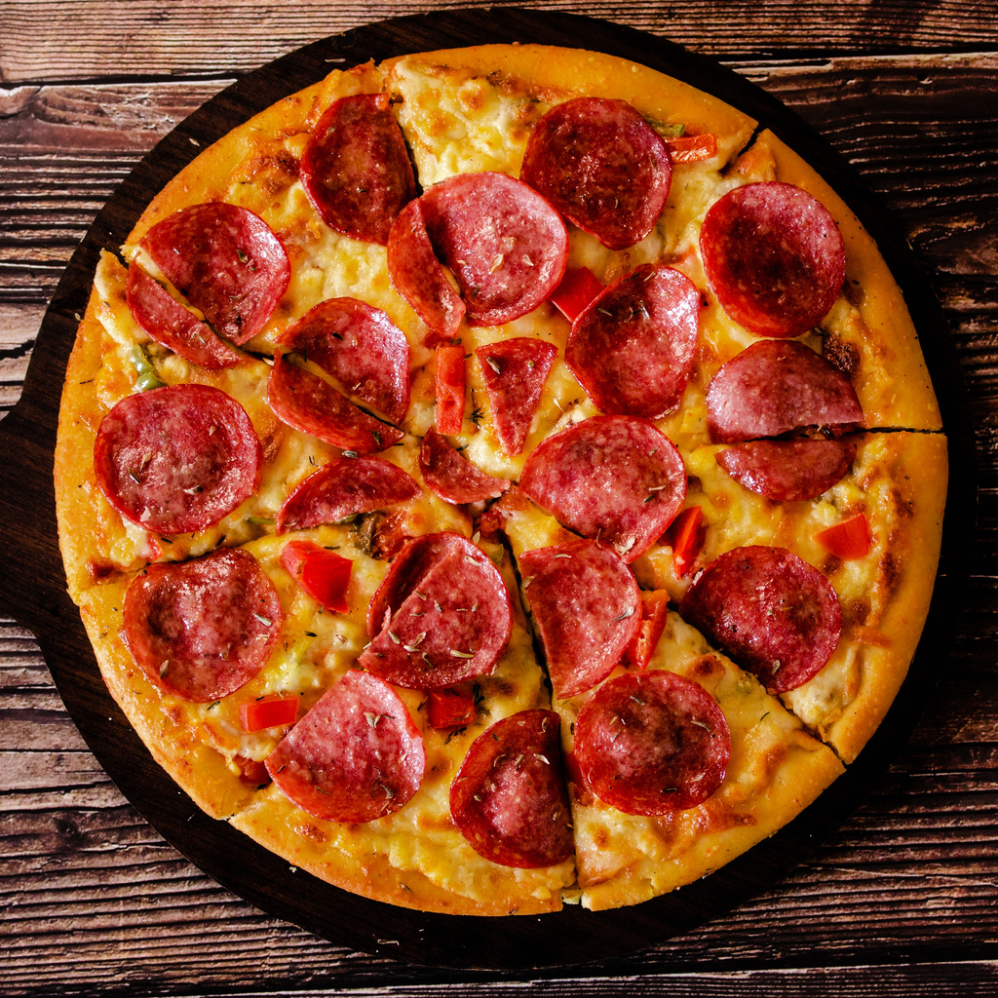
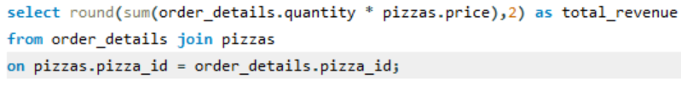
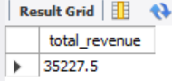
2. CALCULATE THE TOTAL REVENUE GENERATED FROM PIZZA SALES. MAKE USE OF JOIN.
RESULT :

Slide 8
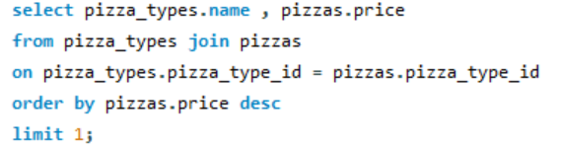
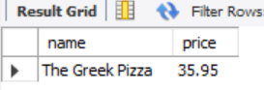
3. Identify the highest prize pizza. :
Results :

Slide 9
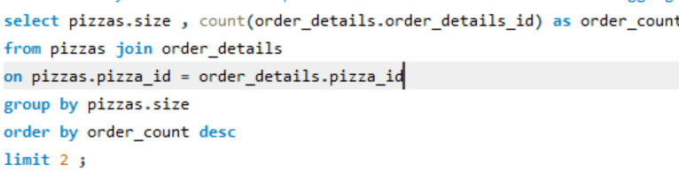
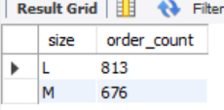
4.IDENTIFY THE MOST COMMON PIZZA SIZE ORDERED.
NOTE: WHEN U USE AGGREGATE FUNCTION MAKE COMPULSORILY USE OF GROUP BY FUNCTION .
RESULTS :

Slide 10
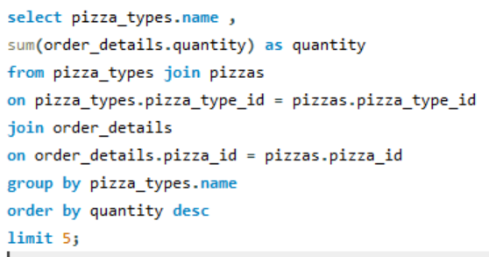
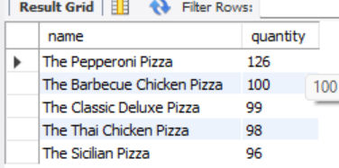
5. LIST THE TOP 5 MOST ORDERED PIZZA TYPES ALONG WITH THEIR QUANTITIES.
RESULTS :

Slide 11
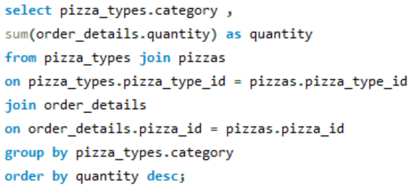
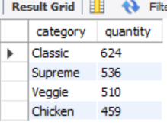
3. intermediate queries :
Join the necessary tables to find the total quantity of each pizza category ordered.
Result :

Slide 12
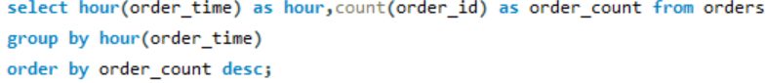
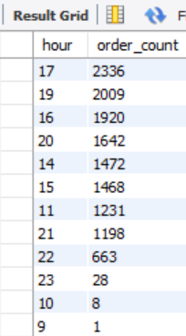
2. DETERMINE THE DISTRIBUTION OF ORDERS BY HOUR OF THE DAY.
RESULTS :

Slide 13
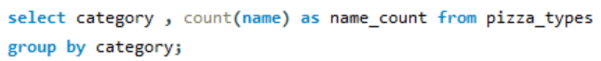
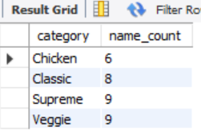
3. JOIN RELEVANT TABLES TO FIND THE CATEGORY-WISE DISTRIBUTION OF PIZZAS.
RESULTS :

Slide 14
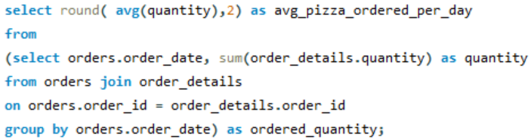
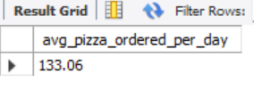
4. GROUP THE ORDERS BY DATE AND CALCULATE THE AVERAGE NUMBER OF PIZZAS ORDERED PER DAY.
RESULT :

Slide 15
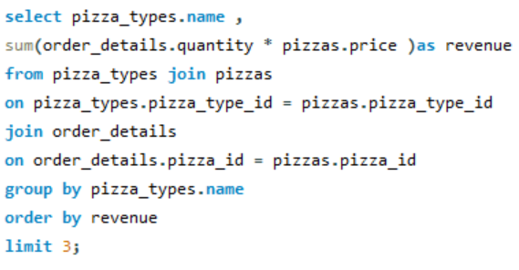
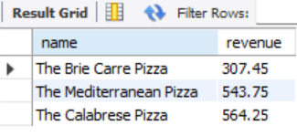
5. DETERMINE THE TOP 3 MOST ORDERED PIZZA TYPES BASED ON REVENUE.
RESULTS :

Slide 16
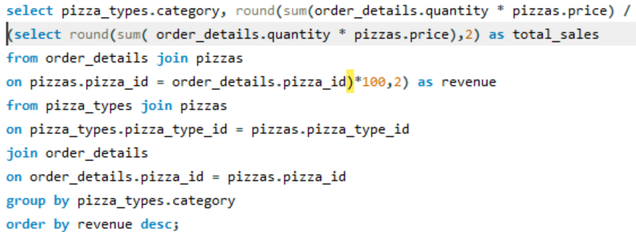
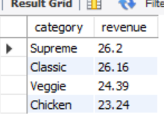
4. hard queries :
Calculate the percentage contribution of each pizza type to total revenue.
Result :

Slide 17
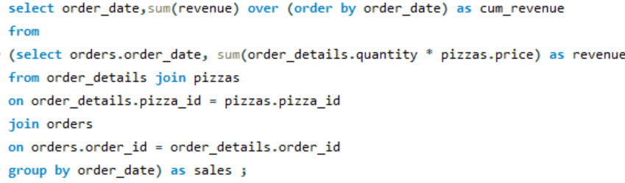
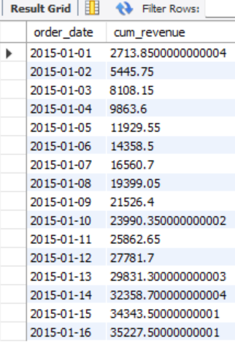
2. ANALYZE THE CUMULATIVE REVENUE GENERATED OVER TIME.
RESULT :

Slide 18
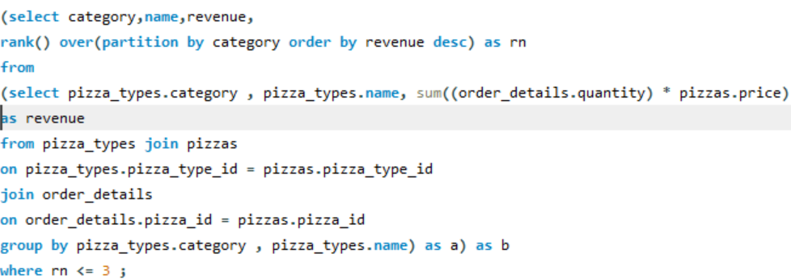
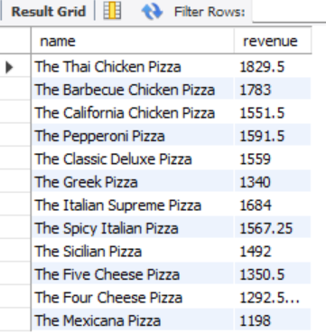
3. DETERMINE THE TOP 3 MOST ORDERED PIZZA TYPES BASED ON REVENUE FOR EACH PIZZA CATEGORY.
RESULTS :

Slide 19

skills used :
DATA MODELING: DESIGNED RELATIONSHIPS BETWEEN MULTIPLE TABLES (ORDERS, ORDER_DETAILS, PIZZAS, PIZZA_TYPES) FOR EFFICIENT QUERYING.
Full Dataset Analysis: Explored 21,350 orders and 48,621 order details to extract valuable trends.
Complex Joins: Used INNER JOIN, LEFT JOIN, and multi-table joins to combine and analyze data.
Advanced SQL Functions: Applied WINDOW FUNCTIONS (RANK, DENSE_RANK), CASE WHEN, CTEs, subqueries, and aggregation for deep insights.
Time-based Analysis: Analyzed daily, monthly, and hourly sales to identify peak business periods.
Performance Optimization: Structured queries for faster execution and accurate results.

Slide 20
Dataset access link :
https://github.com/NNDINI7/SQL-Data-Analysis-Projects

Slide 21
thank you!

